Slide 1
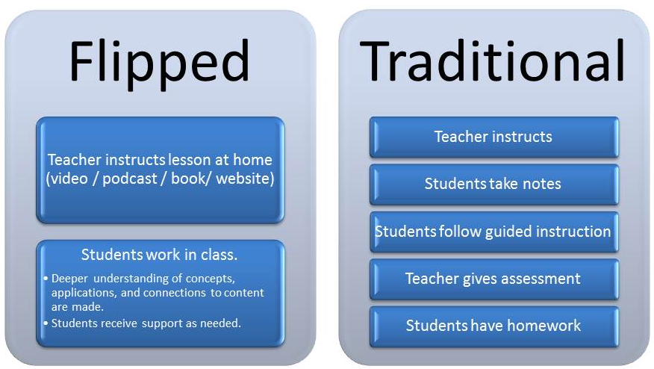
21st Century Thinking Approach to Teaching/ Learning
Notes:
New P3B, flow, focus, future, friend,

Slide 2
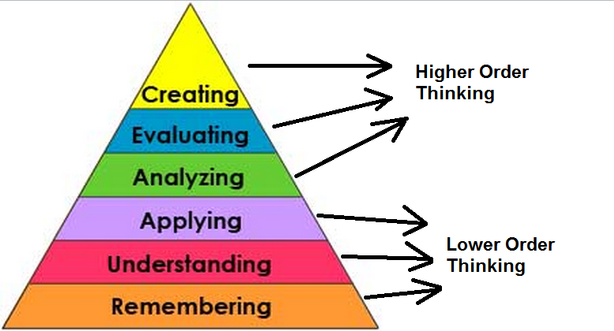
Tutorial Discussion Qs/ Methodology
  Knowledge (K)
  Comprehension (C)
  Application (App)
  Analysis (An)
  Synthesis (Syn)
  Evaluation (Eval)

Slide 3
BT: Cognitive-Domain
EVAL
SYNTHESIS
ANALYSIS
APPLICATION
COMPREHENSION
KNOWLEDGE
Making Ds, sp views,
req values-understanding
Graduate-School
Combining info to
form a unique product
Id components,
arrangement, logic, semantics
Under-graduate
Using info
to solve problems
Restating own words,
Sumarising, translating
High School
Memorizing
verbatim

Slide 4
What is Learning? K/ C/ An
What are the 6 elements of real learning/ intellectual growth? C
  Acquiring new or modifying existing Knowledge, behaviour, skills, values and synthesizing different types of information
Learning is
  Acquiring information
  Comprehending it
  Applying it to hypothetical, practical problems
  Analysing it: Study part by part
  Sythesising it: Assemble parts into something new
  Evaluating synthesized information: For use

Slide 5
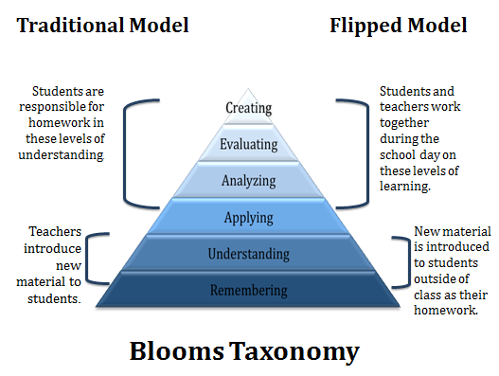
Learning outcomes/ Desired Learning Objectives (DLOs)? K/ C
  Why/ what need to, and able to do after instruction?
Formal statements that articulate
  What students are able to do after instruction?
  Why students need to do this?

Slide 6
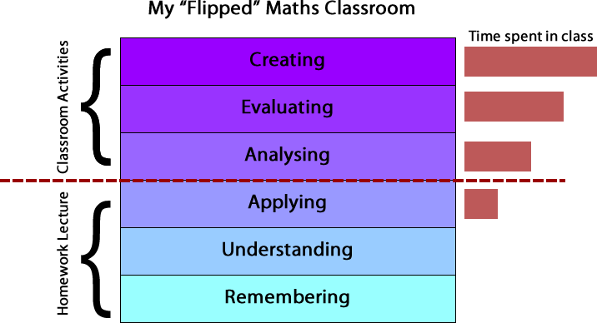

Slide 7
Use of DLOs for students? C/ An
  What students are learning as a result?
Benefits for students
  Know what you are doing?
  Know why you are doing it?
  Know what students are learning as a result?
Flipped classroom inverts traditional teaching methods, delivering instruction online outside of class and moving ‘homework’ into the classroom.

Slide 9
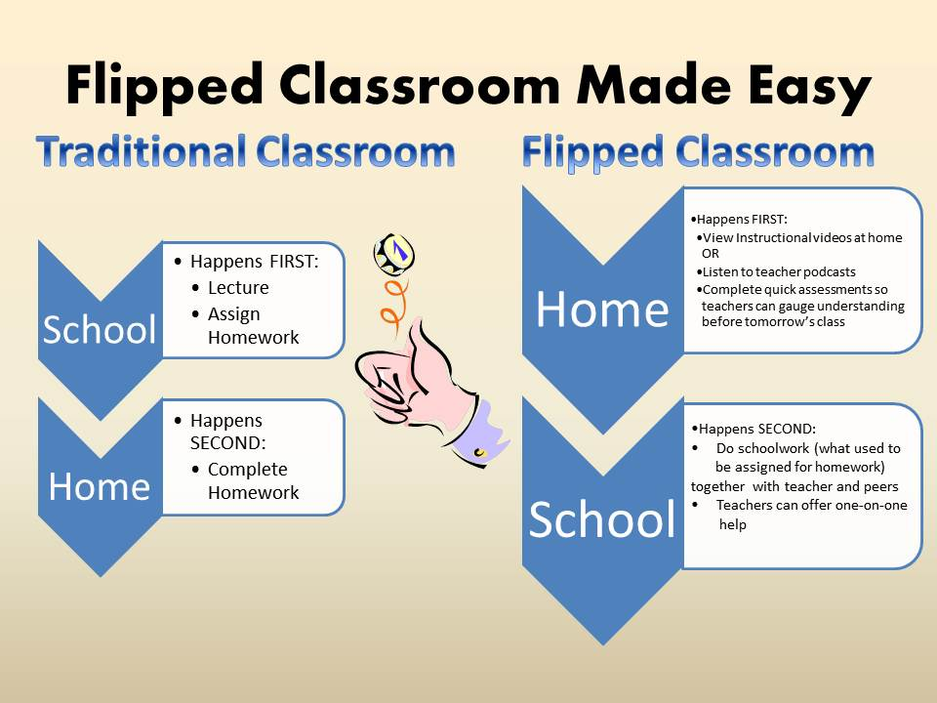

Slide 10
Why Knowledge-CAASE? C/ An
  Shows intellect, accountability, improvement?
It builds evidence for
  Accountability
  Improvement
Show evidence of how well our students learn
Use evidence for continuous improvement

Slide 11
Benefits for teachers: Setting learning outcomes? C/ An
  Content, strategy, instruction materials, assess, evaluate, improve?
Select content
Develop instructional strategy
Develop and select instructional materials
Construct tests/other inst for assessing/ evaluating
Improve you as a teacher, and our overall program

Slide 12
Teachers-Workshop Learning Outcomes? An
  Recognize BT levels, intellect, accountability, improvement?
Attendees will
  Recognize the levels of Bloom’s Taxonomy
  In order to select verbs
  That map to instructional objectives
Analyze BT’s levels
  Discuss a variety of ways
  It can be used in classroom instructions

Slide 13
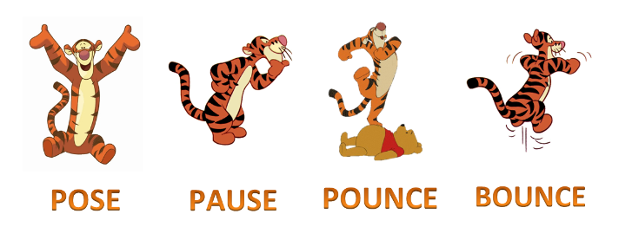
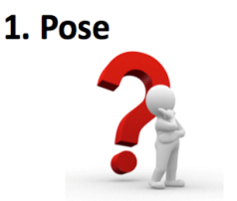
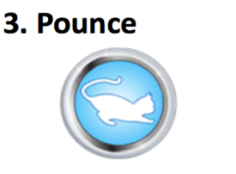


Pose, pause, pounce, bounce
P3B

Slide 14

P3B Strategy: Pose, Pause, Pounce, Bounce
Pose: Give P3B context to the class
  Insist Hands Down before the Q is delivered
  Q/ series of Qs: Ensure reflect
  Pose Q to the class: Not an individual- Then Pause…
Pause: Stop talking- This is the difficult part
  Ask class to hold the thought: Think and think again
  If captivated/ engaged: Hold silence little longer
  Push boundaries: Keep reflection as long as possible
  Then Pounce!

Slide 15
P3B Strategy: Pose, Pause, Pounce, Bounce
Pounce: Insist ans from A/ possibly B direct/ fast!
  Plan in mind who to ask, before speaking to class
  Name student A to respond and don't move from him
  Don't speak/ nip any comments, grunts, noises in bud!
  Wait for ans: Pause- decipher sp, esp if no response
  If student A does manage to answer- then Bounce
Bounce: Ask B opinion on A's answer (imm)
  Dev by asking B and C opinions to A's rt/wrong response
  Addl strat: Bounce Q onto gp A then sub-group B if unsat
  Ensure engage a significant number in this start
  Ensure entire class reflective: Return Pose or Pounce

Slide 16
POSE PAUSE POUNCE BOUNCE
Pose: Insist hands down
  Open ended Qs
  One that is worth their reflection
Pause: For as long as possible- allow thinking time
  Do not be afraid of the silence
  Count to 5 and perhaps to 10
Pounce: Select a student for response
Bounce: Deflect Q another- agree/disagree why?

Slide 17
Why BT? Syn
  Tool: Curriculum, instructions, assessment vs. BT obj?
  Helps HOT, clear products, apply all levels schooling?
It is a more authentic tool for
  Curriculum planning
  Instructional delivery
  Assessment
Helps involve students in higher order thinking
  It provides clarity about the students products
  Can be easily applied to all levels of schooling
  It is a universal classroom planning tool

Slide 18
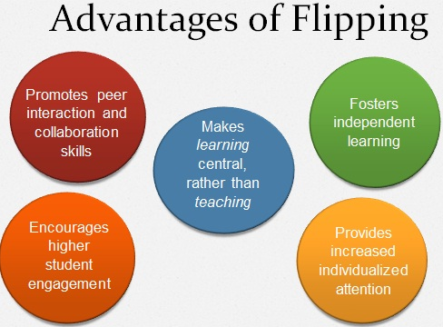
Define Cognitive? C/ An
  Truly know through awareness, perception, reasoning, judgement?
The mental process of knowing, including aspects such as awareness, perception, reasoning, and judgment.
That which comes to be known, as through perception, reasoning, or intuition; knowledge

Slide 19
BENEFITS: Knowledge-CAASE Cognitive Learning
Real intellect-building: Right through/ up to K-CAASE
RRR: Belief in synthesised/ evaluated material
Marks/ grades: Not dependent on particular notes
Effective V-NVR caps: Right through K-CAASE
Thinking leadership: Secure people/ Pakistan
Cover entire syllabus: ½ if not 1/10th the time
In control: Faculty/ members- Much lesser friction
How to think- Not what to think?
Possible: Dr Salam minus?

Slide 20
Def: Cognitive?
  Truly know, reason, intellect on 6 rungs?
1.The mental process of knowing
  Incl aspects such as awareness
  Perception, reasoning, and judgment
2. That which comes to be known as through
  Perception, reasoning, or intuition; knowledge
3. Of relating to, being
  Or involving conscious intellectual activity
  As thinking, reasoning, or remembering
Based/ capable: Being reduced to empirical factual K

Slide 21
Define Knowledge as BT rung 1? K/ C
  Being able to define, list, name recall acquired info?
Recalling previously learned information
  Such as facts, terminology, rules, etc
  Answers may be memorized
  Or closely paraphrased from assigned material
Verbs: Define, list, name, recall

Slide 22
Define Comprehension as BT rung 2? K/ C
  Being able to explain comprehended info?
Ability to comprehend the meaning of material
Answers must be in the student’s own words
  While still using terminology
  Appropriate to the course material
Explain, summarize, distinguish between, restate

Slide 23
Define Application as BT rung 3? K/ C
  Being able to apply learnt K to new situation/ problem?
Requires recognizing, identifying, applying
  A concept or principle in a new situation
  Or solving a new problem
May require
  Identifying or generating examples
  Not found in assigned materials
Verbs: Demonstrate, arrange, relate, adapt

Slide 24
Define Analysis as BT rung 4? K/ C
  Being able to break, differentiate, infer concepts?
Ability to break material down into component parts
  To understand its underlying structure
  May require students to compare and contrast or
  Explain how an example illustrates a concept/principle
Require students to identify logical errors or
  To differentiate among facts, opinions
  Assumptions, hypotheses and conclusions
Expected to draw relationships between ideas
Differentiate, estimate, infer, diagram

Slide 25
Define Synthesis as BT rung 5? K/ C
  Being able: Combine, create, formulate, construct ideas?
Opposite of Analysis
Ability to combine parts to form a new whole
  To synthesize a variety of elements
  Into an original and significant whole
Produce something unique or original
Solve some unfamiliar problem in a unique way
Verbs: Combine, create, formulate, construct

Slide 26
Define Evaluation as BT rung 6? K/ C
  Being able to judge, justify, discriminate ideas?
Ability to evaluate a total situation
  To judge the value of material for a certain purpose
  Combining elements of all the other categories and
  Also value judgments based on defined, fixed criteria
The most important part of the answer is
  The justification and rationale for the conclusion
Judge, critique, justify, discriminate

Slide 27
Define Remembering? K/ C
Remembering: Verbs you think are the best? C/ An
  Listing, defining, naming?
Learner able to recall, restate, remember learned info
  Recognising
  Listing
  Describing
  Identifying
  Retrieving
  Naming
  Locating
  Finding
  Defining
Can you recall information?

Slide 28
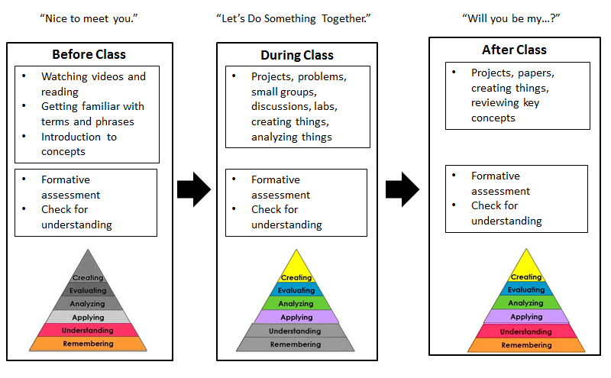

Slide 29
Remembering: The best Verbs/ Products?
List, locate, reproduce, choose/ Define, reproduction?
Recall or recognition of specific information
Listen
Choose
Record
Match
Select
Underline
Cite
Sort
List
Memorize
Show
Locate
Distinguish
Reproduce
Repeat
Label
Recall
Group
Label
List
Reproduction
Vocabulary
Products include
Quiz
Def
Fact
Test

Slide 30
The best classroom-roles for Remembering?
Teacher roles
Directs
Tells
Shows
Examines
Questions
Evaluates
Student roles
Responds
Absorbs
Remembers
Recognizes
Memorizes
Defines
Describes
Retells
Passive recipient

Slide 31
Remembering: The best potential activities and products? An
  Make a story map showing main events of story
  Make a time line of your typical day
  Make a concept map of the topic
  What characters were in the story?
  Recite a poem you have learnt?
  Explain a particular para, sub-topic, character?

Slide 32
Define Understanding? K/ C
Understanding: The best verbs? An
Grasps info-meaning by interpreting/ translating
  Interpreting
  Exemplifying
  Summarising
  Inferring
  Paraphrasing
  Classifying
  Comparing
  Explaining
Can you explain ideas or concepts?

Slide 33
Understanding: The best verbs and products? An
Restate
Identify
Discuss
Retell
Translate
Give examples of
Paraphrase
Reorganise
Describe
Report
Recognise
Observe
Account for
Give main idea
Understanding of given information
Products include
Summary
Collection
Explanation
Show and tell
Example
Quiz
List
Label
Outline

Slide 34
Best Classroom Roles for Understanding? An
Teacher roles
Demonstrates
Listens
Questions
Compares
Examines
Student roles
Explains
Describes
Restates
Translates
Demonstrates
Active participant

Slide 35
Understanding: Best potential activities and products? An
Write in your own words…
Cut out, or draw pictures: Illustrate a particular event in story
Make a cartoon strip showing the sequence of events in the story
Write and perform a play based on the story
Write a brief outline to explain this story to someone else
Explain why character solved the problem in this particular way
Write a summary report of the event
Paraphrase this chapter in the book
Retell in your own words

Slide 36
Define Applying? K/ C
Applying: The best verbs?
Use info in a different context
  Implementing
  Carrying out
  Using
  Executing
Q: Use the information in another familiar situation?

Slide 37
Applying: The best verbs? An
Using strategies, concepts, principles and theories in new situations
Manipulate
Illustrate
Calculate
Interpret
Make
Practice
Apply
Operate
Interview
Paint
Compute
Solve
Collect
Dramatize
Construct
Adapt
Products include
Presentation
Interview
Performance
Diary
Journal

Slide 38
Best Classroom Roles for Applying? An
Teacher roles
Shows
Facilitates
Observes
Evaluates
Organizes
Questions
Student roles
Solves problems
Demo use of knowledge
Calculates
Compiles
Constructs
Active recipient

Slide 39
Applying: Best potential activities and products? An
Construct a model to demonstrate how it looks or works
Practise a play and perform it for the class
Make a diorama to illustrate an event
Write a diary entry
Prepare invitations for a character’s birthday party
Make up a puzzle or a game about the topic
Write an explanation about this topic for others
Dress a doll in national costume
Make a clay model…
Continue the story…
Notes:
Diorama: The word diorama can either refer to a 19th-century mobile theatre device, or, in modern usage, a three-dimensional full-size or miniature model, sometimes enclosed in a glass showcase for a museum

Slide 40
Define Analysing? K/C
Best verbs? An
Break learned info into its parts to best understand that information
  Comparing
  Organising
  Deconstructing
  Finding
  Structuring
  Integrating
Break info into parts to explore understandings/ relationships?

Slide 41
Analysing: Best verbs? An
Breaking info down into its component elements
Distinguish
Appraise
Experiment
Inspect
Examine
Separate
Inquire
Arrange
Investigate
Research
Calculate
Criticize
Compare
Contrast
Survey
Debate
Categorize
Products include:
Graph
Chart
Survey
Report

Slide 42
Best classroom roles for Analysing? An
Teacher roles
Probes
Guides
Observes
Evaluates
Acts as a resource
Questions
Organises
Student roles
Discusses
Argues
Debates
Thinks deeply
Examines
Questions
Calculates
Investigates
Inquires
Active participant

Slide 43
Analyzing: Best Potential activities and products? An
Design a questionnaire to gather information.
Survey classmates to find out
  What they think about a particular topic
  Analyse the results
Classify the actions of the characters in the book
Construct a graph to illustrate selected information.
Make a family tree showing relationships.
Devise a role-play about the study area.
Write a biography of a person studied.
Prepare a report about the area of study.
Conduct an investigation to produce info to support a view

Slide 44
Synthesis/Creating: Best verbs/ ideas, why? An
Creates new ideas/ info from previously learned info
  Designing
  Constructing
  Planning
  Producing
  Inventing
  Devising
  Making
Generate new products, ideas, ways of viewing?

Slide 45
Creating: Best verbs- why? An
Compose
Assemble
Organise
Invent
Compile
Devise
Propose
Construct
Formulate
Improve
Plan
Prepare
Develop
Generate
Putting together ideas or elements to develop a original idea or engage in creative thinking.
Products include
Film
Story
Project
Plan
New game
Song
Newspaper
Media product
Advertisement
Painting

Slide 46
Best classroom roles for creating- why? An
Teacher roles
Facilitates
Extends
Reflects
Analyses
Evaluates
Student roles
Designs
Formulates
Plans
Takes risks
Modifies
Creates
Proposes
Active participant

Slide 47
Creating: Best potential activities and products- why? An
  Invent a machine to do a specific task
  Create a new product. Name/ plan marketing campaign
  Write about your feelings in relation to...
  Write TV show, play, puppet show, role play, song about
  Design a new monetary system
  Dev new restaurant-menu with variety of healthy foods
  Design a record, book, magazine cover for...

Slide 48
Evaluating: Best verbs/ ideas? An
Ds based on in-depth reflection, criticism, assessment
  Checking
  Hypothesising
  Critiquing
  Experimenting
  Judging
  Testing
  Monitoring
Can you justify a decision or course of action?

Slide 49
Evaluating cont
Justify
Recommend
Discriminate
Appraise
Probe
Criticise
Rank
Reject
Judging the value of ideas, materials and methods by developing and applying standards and criteria.
Judge
Rate
Validate
Assess
Determine
Priorities
Compare
Evaluate
Defend
Measure
Products include
Report
Evaluation
Investigation
Conclusion
Persuasive speech

Slide 50
Best classroom roles for Evaluating? An
Teacher roles
Clarifies
Accepts
Guides
Student roles
Judges
Disputes
Compares
Critiques
Questions
Argues
Assesses
Decides
Selects
Justifies
Active participant

Slide 51
Evaluating: Best potential activities and products: An
Write a letter to the editor
Prepare and conduct a debate
Prepare a list of criteria to judge…
Write a persuasive speech arguing for/against…
Make booklet about 5 imp rules- Convince others
Write a letter to. ..advising on changes needed
Write a half-yearly report.
Evaluate the character’s actions in the story

Slide 52
Direct guidance for good BT-questions? An
  Qs to: Purpose, goals, classify complexity, vary levels?
Use questioning purposefully: achieve well-defined goals
BT: Classifies thinking by level of complexity
  Gives opportunity: Learn/ practice range of thinking skills
  BT involves all categories of questions
Typically: Vary level of Qs within a single lesson

Slide 53
Teachers Guidance: How ask BT Qs? An
What does BT do for what purpose?
  Purposefully to achieve clear obj?
  Classify T by complexity: To practice range of T-Skills?
Use Qs purposefully: Achieve well-defined obj/ goals
BT: Classifies thinking by level of complexity
  Gives opportunity: Learn/ practice range of T-skills
  BT involves all categories of questions
Typically: Vary level of Qs within a single lesson

Slide 54
Purpose: Lower Order Questions? C/ An
  Evaluate preparation/ C?
  Diagnose strengths/ weaknesses?
Those at: Remembering, understanding level
Usually questions at lower levels are appropriate for
  Evaluating: Students’ preparation and comprehension
  Diagnosing: Students’ strengths and weaknesses
  Reviewing or summarizing content

Slide 55
Purpose: Higher order Qs? C/ An
  Analysis, evaluation, creation skills?
  Encourage deep, crit TSs, self-directed learners?
Higher Order Qs: Requiring complex application
Appropriate: For analysis, evaluation, creation skills
  Encourage students to think deeply and critically
  Problem solving
  Encouraging discussions
Stimulating students to seek info on their own
  Go beyond textual material in that
  Must be inferred/ extrapolated from assigned material
For creativity, originality, crit thinking at higher levels

Slide 56
Purpose: HOT skills? C/ An
  Connect fact to one-another, cat, new solutions?
Not memorization: Do something with the facts
Must understand/ connect them to each other
  Categorize, manipulate them
  Put them together in new or novel ways
  Apply them as we seek new solutions to new problems
  Higher Order Thinking involves Metacognition

Slide 57
Best questions for Remembering: C/ An
What happened after...?
How many...?
What is...?
Who was it that...?
Can you name ...?
Find the definition of…
Describe what happened after…
Who spoke to...?
Which is true or false...?

Slide 58
Best questions for Understanding: C/ An
Can you explain why…?
Can you write in your own words?
How would you explain…?
Can you write a brief outline...?
What do you think could have happened next...?
Who do you think...?
What was the main idea...?
Can you clarify…?
Can you illustrate…?
Does everyone act in the way that …….. does?

Slide 59
Best questions for Applying? C/ An
Do you know of another instance where…?
Can you group by characteristics such as…?
From given info, develop a set of instructions about…?

Slide 60
Best questions for Analysing? C/ An
Which events could not have happened?
If. ..happened, what might the ending have been?
What do you see as other possible outcomes?
Can you distinguish between...?
What were some of the motives behind..?
What was the turning point?
What was the problem with...?

Slide 61
Best questions for Creating? C/ An
Can you design a...to...?
Can you see a possible solution to...?
If you had access to all resources, how would you deal with...?
Why don't you devise your own way to...?
How many ways can you...?
Can you create new and unusual uses for...?
Can you develop a proposal which would...?

Slide 62
Best questions for Evaluating? C/ An
Can you defend your position about...?
Do you think...is a good or bad thing?
How would you have handled...?
What changes to.. would you recommend?
How effective are. ..?
What are the consequences..?
What influence will....have on our lives?
What are the alternatives?
Who will gain & who will loose?

Slide 63





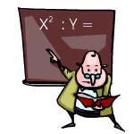
Activity 1: What BT level?
Changing a flat tire?
Finding the main idea of a paragraph
Explaining a class lecture to a friend who was absent
Summarizing an Article
Finding the lowest common denominator for fractions
Finding the correct answer to a multiple choice Q

Slide 64
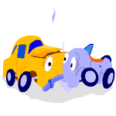





Activity 1: What BT level?
Creating a webpage
Appraising the damage to your wrecked car
Listing the states and capitals
Making an apple pie
Comparison shopping for the best buy
Writing an essay for English class
Computing your GPA

Slide 65
Activity 2: Jack and Jill
IN groups: Will be assigned a BT-level
Read Goldilocks: Dev Qs/ activity to teach your class
You have ------- minutes to
  Prepare your lesson/activity
  Then present it to the rest of us

Slide 66

Using BT in the Classroom: Jack and Jill?
Analyzing: How is this story related to your life?
Remembering: Who was the main character?
Understanding: The main idea of the story?
Applying: What Qs in an interview with the main character?
Creating: Adapt
Plot: Create different story?
Analyzing: How is this story related to your life?
Evaluating: What choices if you in story?

Slide 67

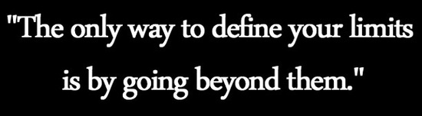
Jack and Jill: BT Qs
KNOWLEDGE: Recall of specific information
  Who was Jack?
  Where did Jill live? With whom?
  What did she do at the hill?
C: An understanding of what was read
  This story is about ___________ (topic)
  This story tells us _________(main idea)
  What did Jack look like?

Slide 68

Jack and Jill: BT Qs
APP: Convert abstract content to concrete situations
  Were JJs like real people?
  Why did JJ go up the hill?
  Draw a picture of what the pail looked like.
  Draw a map showing the episode.
AN: Comparison/ contrast content to p experience
  How did you react to what JJ did?
  How would you react if they had not tumbled down?
  Compare JJ to any of your friends.

Slide 69

Jack and Jill: BT Qs
SYNTHESIS: Org of thoughts, ideas, info from content
  List events of the story in sequence
  Stories about little girls/boys who escaped tumbling?
  Make a puppet out of one of the characters.
  Using the puppet, act out his/her part of the story

Slide 70

Evaluation
The judgment and evaluation
  Of characters, actions, outcomes etc
  For personal reflection and understanding
Why did JJ tumble down?
Explain/ ans: JJ were happy even after tumbling?
Explain: Jack fell down, broke his crown?
Like getting into a similar situation? Why/ why not?

Slide 71
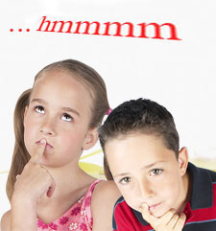
Jack and Jill: BT Qs
Do you think this really happened to JJ? Why/ not?
Why would a grown-up write this rhyme for children?
Why JJ has been told to kids for many, many years?

Slide 72

Make a Mnemonic Device? Syn/ Eval
Killing Knowledge
Cats Comprehension
Almost Application
Always Analysis
Seems Synthesis
Evil Evaluation
OR K-CAASE: Brief-case your knowledge

Slide 75
Unit 5: Gravitation
Physics-IX

Slide 76
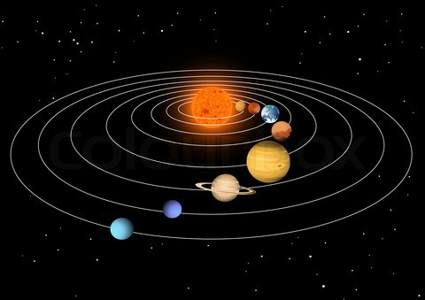
Do you agree with this linkage? Eval
  LOM?
Conceptual Linkage
This chapter is built on
  Gravitation- Science-V
  Earth & Space- Science-VI
This chapter leads to:
  Gravitational Potential
  Escape Velocity
  Artificial Satellite------Physics-XI

Slide 77
Would you incl any more concepts in The Gravity Chap? Eval
  LOG and third LOM?
Major Concepts
  5.1 Law of Gravitation (LOG)
  5.2 Measurement of mass of Earth
  5.3 Variation of g with altitude
  5.4 Motion of artificial satellites

Slide 78
Which K-CAASE domain for these DLOs? C
DLOs: After studying this unit, students will be able to:
  State Newton's LOG
  Explain: G- forces are consistent with Newton's 3rd LOM
  Explain G-field as an example of field of Force.
  Define weight (as force on an object- due to a G field)
  Calculate mass of Earth by using LOG
  Solve problems using Newton's LOG
  Explain: G-value decreases with alt from earth’s surface
  Discuss imp of LOG in understanding satellite-motion

Slide 79
Useful: Predict acceleration due to gravity g-value?
Why know Newton’s LOG? C
  Wt cals hence forces acting on bodies cals anywhere?
  Is the maj concept: Helps prove many equations?
Science- Technology- Society Connection
Gather information to
  Predict the value of the acceleration due to gravity g
  At any planet or moon's surface
  Using Newton's LOG
Describe how artificial satellites
  Keep on moving around the earth
  Due to gravitational force

Slide 80
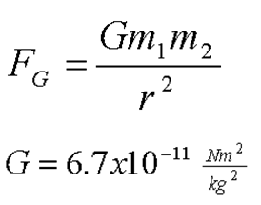
How many centuries back: LOG discovered? K
Explain: Concepts related to gravity? C
  4oo years back? 786-809 Harun Rashid? 1126-98 Rushd?
  LOG, LOM, mass of Earth, g with altitude, artificial sat?
First man Issac Newton: Idea of gravity was
  1665: Trying solve why planets revolve around sun
  Suddenly an apple fell from the tree
  The idea of gravity flashed in his mind
He discovered not only the cause of falling apple
  But also cause that makes planets revolve around sun
  And the moon around the Earth
This unit deals with the concepts related to gravity
Notes:
Abbasid, ruled most of the Muslim world from 750 to 1258. The city of Baghdad was built in 762 as the capital of the new caliph, Abu-al-Abbas, a descendant of the Prophet's uncle. The Abbasids owed their initial success to the discontent of the non-Arabic Muslims, who were the primary leaders in the towns and in the Shia.
The fall of the Umayyad Dynasty marked the end of Arab domination within
Islam; the Abbasid caliph made great effort to establish equalitarian
treatment of all Muslims.

Slide 81
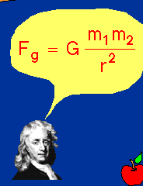
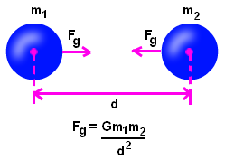
How are 2 Fs same: Falling apple and orbiting moon? Syn
Both caused by LOG?
Force of Gravitation: On basis of observations
  Concluded: F which causes an apple to fall on the earth
  And the F which keeps the moon in its orbit
  Are of the same nature
He further concluded: there exists a F due to which
  Everybody in universe attract every other body
  He named this force the force c gravitation

Slide 82
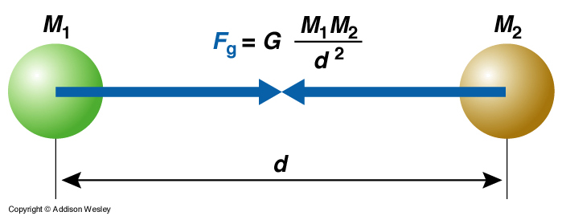
How many concepts/ parts/ elements to define LOG? An
  4 elements: G, mass, distance, g?
LOG: Everybody in the universe
  Attracts every other body with a force
  Directly proportional to the product of their masses
  Inversely prop to sq of distance between their centres
Consider two bodies of masses ml and m2 (fig 5.1)

Slide 83
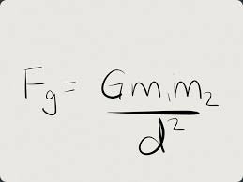
Explain the LOG formula with examples? An
  Examples: Falling apple, satellites?
According to LOG: Gravitational force of attraction F
  With which the two masses m1 and m2
  Separated by a distance d, attract each other is given by
Formula: F α m1 m2, But F α 1/ d²
  F α (m1 m2)/ d²
  F=G x (m1 m2)/ d²
Here G is the proportionality constant
  It is called the universal constant of gravitation
  Its value is same everywhere

Slide 84

Define proportionality and its constant? K/ C
What are directly proportional in F=ma and why?
  As one amount increases other increases- same rate?
  Constant Prop: In which one value changes same way?
  Fα ma, m α 1/a?
Directly proportional: as one amount increases
  Another amount increases at the same rate
  A constant ratio: In which one value changes same way
Example: you are paid $20 an hour
  How much you earn: Directly prop to how many hrs work
  Work more hours, get more pay; in direct proportion
This could be written: Earnings ∝ Hours worked

Slide 85
Why earnings and hours are directly proportional? An
Why x proportional to y is written as x/y= K
  2/ 3 hrs @ 20 per hour: 40/60 Rs?
  Because x α y, x/y=K?
This could be written: Earnings ∝ Hours worked
  If you work 2 hours you get paid $40
  If you work 3 hours you get paid $60
Constant of Proportionality
  Constant of Prop: Value that relates the two amounts
Example: Paid $20 an hour: Constant of Prop is 20 due
  Earnings = 20 × Hours worked

Slide 86
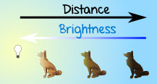
Define inverse proportionality/ constant? K/C
What is inversely prop in F=G x (m1 m2)/ d² - why?
  One value decreases at same rate that other increases?
  F α m1 m2 and α d² and F is the Constant?
Inversely Proportional: when one value decreases at the same rate that the other increases
A constant ratio between two values in which one value changes in the opposite way as the other
Example: light and distance
  The further away you are from a light, the less bright it is
  As distance increases, brightness decreases
  And as distance goes down, brightness goes up

Slide 87
How spd, travel time inversely prop? An
Why y inversely prop to x written as y=K/x?
  As speed goes up, travel time goes down?
  Because y= K/x?
Example: speed and travel time
  Speed and travel time are Inversely Proportional
  Because the faster you go the shorter the time
  As speed goes up, travel time goes down
  And as speed goes down, travel time goes up
Thus: y is inversely proportional to x
  Is the same thing as: y is directly proportional to 1/x
  Which can be written: y = k/x

Slide 88
Why G units are in 6.67384 × 10⁻¹¹ m³ kg⁻¹ s⁻²? Syn
  Because G= Fd²/ (m1 m2)?
In SI units its value is 6.67384 × 10⁻¹¹ m³ kg⁻¹ s⁻²
Due to small value of G between objects around us
  The gravitational force of attraction is small
  And we do not feel it
  Large Earth mass: attracts nearby obj with a large F
The weight of an object on the' Earth
  Result of gravitational force of attraction
  Between the Earth and the object

Slide 89
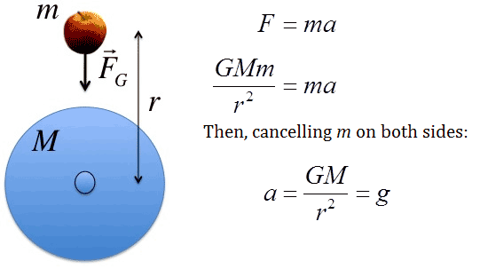
Why 3rd LOM is consistent with LOG? Syn
  Forces on both bodies are action/ reaction due LOG?
LOG and Newton's Third LOM: It is to be noted that
  Mass m1 attracts m2 towards it with a force F
  While m2 attracts m1 towards it with same magnitude F
  But in opposite direction
If the force acting on m1 is considered as action
  Then the force acting on m2 will be the reaction
  The action and reaction due to FOG
  Are equal in magnitude but opposite in direction.
This is consistent with Newton's third LOM

Slide 90
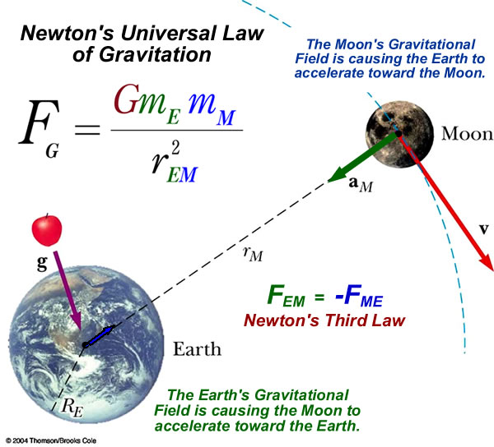
How earth’s g-force keeps moon in orbit?

Slide 91
Will constant G be calculated with same formula? An
  Y: Substitute mass of body/ earth with dist in between?
Example 5.1: Two lead spheres each of mass 1000 kg
  Are kept with their centres 1 m apart
  Find the g-force with which they attract each other
  m1/m2= 1000 kg , d= 1m, F=G x (m1 m2)/ d²
  Putting the values: 1000 kg x 1000 kg
  F= (6.673 x 10⁻¹¹ Nm² Kg-² x 1000 x 1ooo)/ 1 m²
  = 6.673 x 105⁻⁵ N
Thus g-force of attraction = 6.673 x 105⁻⁵ N

Slide 92
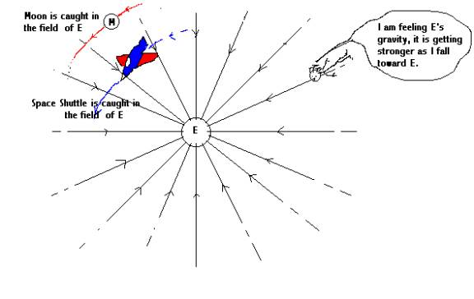
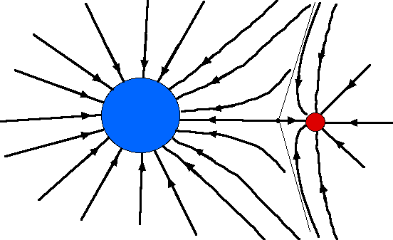
Explain relationship of values in LOG formula? Syn
Explain G Field with LOG Formula? Syn
  FOG α (m M_{e})/ r² ?
  Manifestation of Universal LOG?
Gravitational Field: According to the Newton's LOG
  The g-force between a body of mass m and Earth
  F=G x (m M_{e})/ r²
  Where Me is the mass of the Earth
  And r is distance of body from centre of the Earth
The weight of a body is due to the gravitational force
  With which the Earth attracts a body
  Gravitational force is a non-contact force

Slide 93

Why does a body accelerate as it falls to earth?
  It is within the g-field of the earth?
For example, the velocity of a body
  Thrown up goes on decreasing
  While on return its vel goes on increasing
This is due to the gravitational pull of the Earth
  Acting on body: Whether in contact with earth or not
  Such a force is called the field force
It is assumed that a g-field exists all around the Earth
  This field is directed towards the centre of the earth
  As shown by arrows in figure 5.3

Slide 94
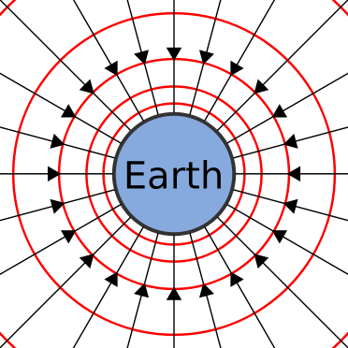
Why does g-field become weaker with distance from earth? An
Why g-field near earth surface is 10 N kg⁻¹ ? Syn
  Because of r² in the denominator?
  Max because of min distance from earth's center?
The g-field becomes weaker and weaker
  As we go farther and farther away from the Earth
In the g-field of the Earth: Force per unit mass is
  Called the g-field strength of the Earth
  At any place its value is equal to value of g at that point
  Near earth’s surface: g-field strength is 10 N kg⁻¹

Slide 95
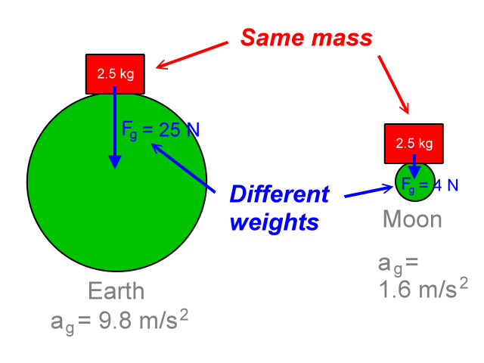
Formula to calculate earth’s mass? C
    F=G x (m M_{e})/ R² ?
5.2 Mass Of the Earth
  Consider body of mass m on Earth surface (figure 5.4)
  Let the mass of the Earth be M, and radius be R
  Distance of body from Earth-centre will also be R
LOG: g-force of Earth acting on a body is given by
  F=G x (m M_{e})/ R²
But the force with which Earth
  Attracts a body towards its centre
  Is equal to its weight w. Therefore …

Slide 96
Why/ how F= w= mg = G (m M_{e})/ R² ? An
Will earth’s wt always= Me= (R² g)/ G? C
  Wt of the body= w= mg, the two m cancel out?
  Yes: Because mass of the object cancels in the eqn?
Therefore F= w= mg = G (m M_{e})/ R²
  g= (G M_{e})/ R² or Me= (R² g)/ G
  M can be determined on putting the values in eqn (5.7)
  M_{e} = (6.4 x 10⁶ m)² x 10 ms⁻² / (6.673 x 10 ¹¹ Nm² kg⁻² )=
6.0 x 10²⁴ kg is mass of the earth

Slide 97
Mini-Ex:
  Does an apple attract the earth towards it?
  With what F apple of 1 N attracts the earth?
  Does the apple weigh same at mountain top?

Slide 98
Qualify : Value of g on surface depends on m and R? An
Value of g on some objects:
Object g (ms⁻²)
  Sun 274.2
  Mercury 3.7
  Venus 8.7
  Moon 1.62
  Mars 3.73
  Jupiter 25.94

Slide 99
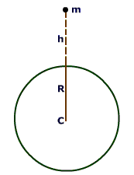
Why does value of g decrease with alt? An
5.3 Variation of g with Altitude
  Equation (5.6): g= (G M_{e})/ R²
  Thus value of acceleration due to gravity g
  Depends on the radius of the Earth at its surface
Value of g is inversely α to sq of earth radius
  But it does not remain constant
  It decreases with altitude
  Alt is height of an object or place above sea level
  The value of g is greater at sea level than at the hills
W = mg_{h}
h
R

Slide 100
Why g is 1/4th of value on earth at one R above? An
Consider a body of mass m at altitude h (fig 5.5)
  Distance of body from earth-centre becomes R+ h
  Therefore, using equation (5.6) g= (G M_{e})/ R² we get
  G_{h} = G M_{e} / (R+h)²
According to the above equation
  At height equal to one Earth R above earth-surface
  g becomes one fourth of its value on the Earth
Similarly at a distance of two Earths radius above
  Value of g becomes one ninth of its value on the Earth

Slide 101
What would be g at 3200 km above earth surface? App
W = mg_{h}
h
R
Example 5.2: Calculate the value of g
  The acceleration due to gravity at an altitude 1000 km
  The mass of 6.0 x 10²⁴ kg, radius of the Earth is 6400 km
Q: g_{h}? R + h= 6400 km + 1000 km=
  7400 km= 7.4 x 10⁶ m
  G_{h} = G M_{e} / (R+h)²
  = (6.673 x 10⁻¹¹ N m² kg² x 6.0 x 10²⁴ kg)/ (7.4 x 10⁶ m)²
7.3 N kg⁻¹ = 7.3 ms⁻²
Thus the value of g at 1000 km alt will be 7.3 ms⁻²

Slide 102
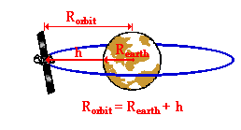
Define satellite? K
5.4 Artificial Satellites
  An object that revolves around a planet is called a sat
Scientists have sent many objects into space
  Some of these objects revolve around the Earth
  These are called artificial satellites
  The moon: Is a natural satellite of the Earth
Most of the artificial sats
  Orbiting around earth: used for comm purposes
  Carry instruments/ passengers for experiments in space

Slide 103
Why comm sats complete one revolution in 24 hours? An
Why do these appear stationary? An
Many artificial sats in different orbits around Earth
  Take different t for one revolution around the earth
  Depending upon their distance h from the Earth.
  Comm sats take 24 hours to complete one revolution
As Earth also completes its one rotation
  About its axis in 24 hours
  Hence, these comm sats appear stationary wrt earth
  Thus their orbit is called geostationary orbit
Dish antennas send/ receive signals from them
  Have fixed direction depending upon their Earth loc

Slide 104
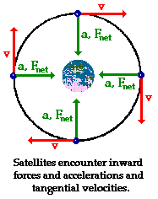
What force keeps them in orbit? C
Where does this F come from? C
Motion of Artificial Sats: A sat req centripetal force
  That keeps it to move around the earth
  G-force of attraction between satellite and earth
  Provides the necessary centripetal force
Consider a satellite of mass m revolving round Earth
  At an altitude h in an orbit of radius r
  With orbital velocity V₀
The necessary centripetal force equation (3.26)
  F_{c} = mV₀²/r₀

Slide 105
This force. is provided by the g-force of attraction between the Earth and satellite and is equal to the weight of the satellite W/ (mg_{h})
  F_{c} = W = mg_{h} = mV₀²/r₀
  V₀² = g_{h} r₀
  V₀ = √(g_{h} r₀)
  r₀ = R+ h
  V₀ = √g_{h} (R+h)

Slide 106
Equation (5.10) gives the velocity
  Which a satellite must possess
  When launched in an orbit
  Of radius r₀ = (R + h) around the Earth
An approximation can be made
  For a sat revolving close to Earth such that R>> h
  Then g_{h} = g
  V₀ = √(g R) ……(5.12)
A satellite revolving around very close to Earth
  Has speed V₀ nearly 8 Kms⁻¹ or 29000 kmh⁻¹

Slide 107
Ht of a geostationary sat is 42300 km/ vel wrt earth is zero? An
GPS: 24 sats
  Revolve around earth twice a day
  Speed: 3.87 km/ sec
Moon 3,80,000 km from earth
  Completes one revolution in 27.3 days

Slide 108
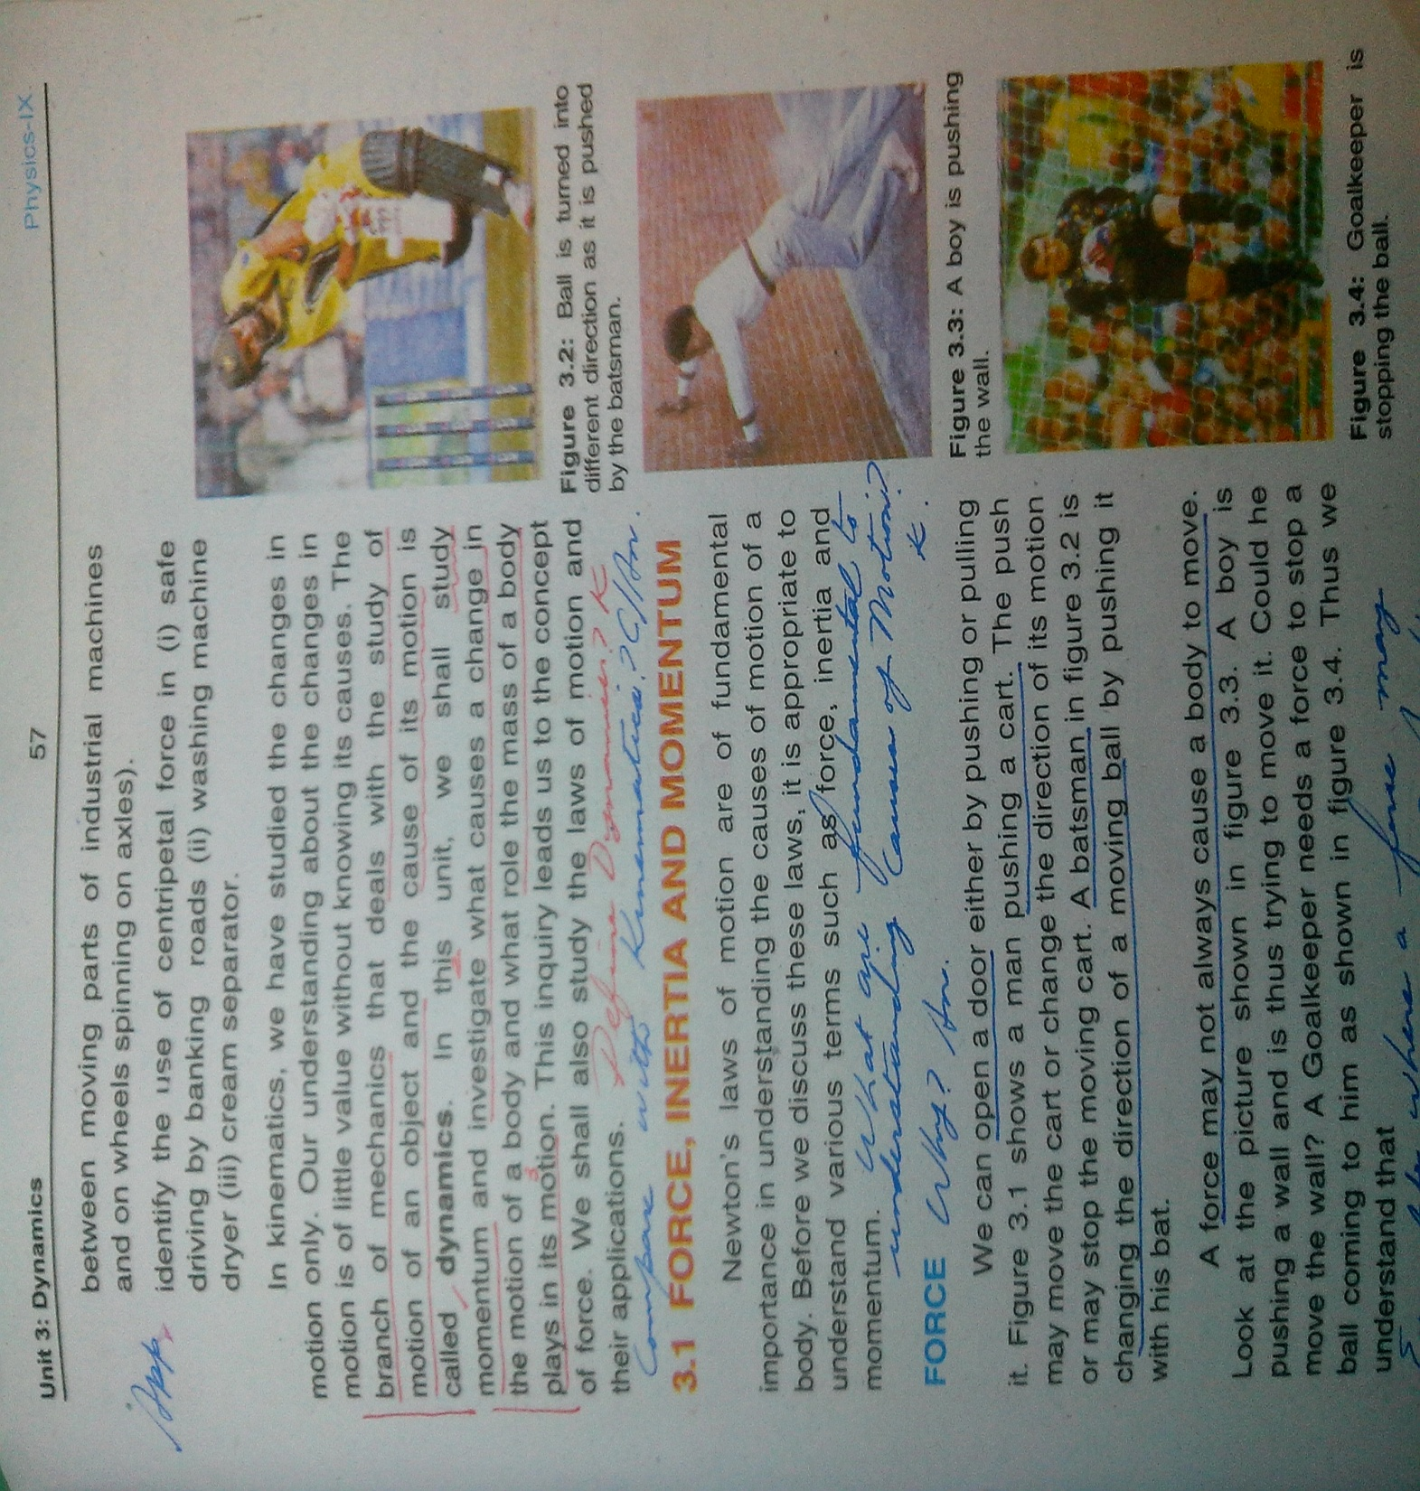

Slide 113


Slide 114
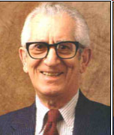
Who was Bloom
An American edu psychologist at Chicago University
Died at: September 13, 1999 (aged 86)

Slide 115
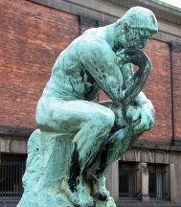
1948: Benjamin Bloom and a group of psychologists
  Studied classroom activities and goals
  Teachers has while planning these activities
Three domains concluded
  Cognitive: Split into a hierarchy of 6 thinking skills
  1956: Original BT published
Taxonomy
  Arrangement
  Classification
  Categorization

Slide 116
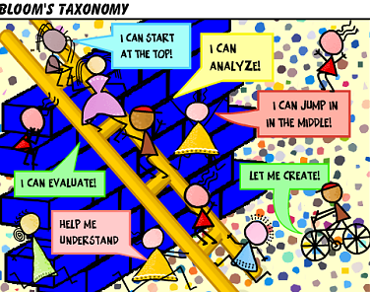
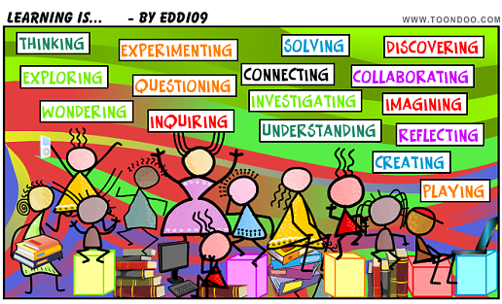


Slide 117
Flipped learning
Technology-Rich Learning - Flip Your Students' Learning
By Aaron Sams and Jonathan Bergmann

Slide 118
How does F-Learning enable S-centered approach? An/ Syn
  LOT/ HOT at home and class?
F-learning helps: Move away from direct instruction
  As primary teaching tool
  Toward a more student-centered approach
When hear flipped classroom/ learning: First thought
  A teacher-created video that students watch at home
  As if essential ingredient. It's not.
  Not about how to use videos in your lessons
About how best use in-class time with students
Forcing KG-college teachers reevaluate how teach!

Slide 119
Advantage of a teacher-created video? An
  Enables HOT, differentiating instruction?
Lecturing: Not the best use of their in-class time
  Not 1-on-1 S-interaction and deliver imp content
  Not engage S in higher-order thinking (HOT)
  Not differentiating instruction
But teachers would have time to do these things
  If shift direct instruction onto a teacher-created video
  Have students watch the lecture at home

Slide 120
What is Flipped Classroom? C/ An
  Watch/ understand interactive LOT-lecture at home?
FC: Conventional- Watch lecture in class
  Then go home: Practice the learnt thus word homework
  Now watch lecture at home: Then come to class
  To practice the learnt: Thus homework in class
Freed from delivering whole-class instruction
  During that hour: Can now deliver targeted instruction
  1-on-1 or in small groups
  Help who struggle- challenge who mastered content

Slide 121
Which classrooms lend themselves to flipping? Syn
  Didactic/ instructive vs. Socratic/ abstract?
More Socratic or inquiry-based courses
  Or without reams of factual content for students
  Aren't particularly suited to flipping
Contrarily: More didactic (instructive) courses
  With large quantities of LOT/ BT content
  In remembering/ understanding cats
  Likely greater transformation in the flipped classroom

Slide 122
Complex/ abstract subjects

Slide 123
What do we understand by “meaning of our service”? C/ An
  No 1 Id: Pakistani, joint then air warrior, specialist, indl
  Know, believe in ACES, CCs, Why am I here?
Shamim Alam brother/ Salim Sandal 1 vs. 1?
IAS Identity?
  Pakistan: PAPA, DFETS, N-DEF-PP
  Joint Warrior: ?
  Air Warrior: OBAF, ACES, IDE
  Specialist: OBIAS, SAFE O-Z, ICE
  Great indl?

Slide 124
Where/ how do the USAF personnel fit into the Air Force? C/ An
Where does the USAF fit into US Military? Syn
How do they define this relationship? Syn
  US: Secular, LLP, DEF-P
  MIL: Provide mil options to deter war/protect n security
  USAF: Fly, fight, win in air, space/cyberspace
  Vision: Global Vigilance, Reach and Power
  ISE, Dev Airmen/ Integ techno to war fighting/ Integ ops

Slide 125
What are we evaluated for at ISSB? Syn
What relationship it has with our careers? Syn
  VNVR and C-PRIDE?
  Cap to take info, gel, prioritized options, implement?
  OODA/ P-RAPDA and review: Extreme pressure/ stress?
Reviewed for: Verbal- Non Verbal Reasoning?
  Through Courageous-PRIDE?
Should be able to: K-CAASE both item by item?
  Internalize and show belief in all?
Be able to: Take in/ gather scores of info under stress
  Gel into a picture, throw up 5 options
  Implement option-1 through VR/ PM-skills?
  Review the next moment

Slide 126
The fc paradigm

Slide 127
Where face-to-face instruction gives max benefit? Syn
What comes out after deciding 2 Qs? Syn
  In class: During HOT teaching/ learning?
  Create videos: To time-shift traditional lectures?
What Comes Out: After deciding
  Q 1: Where face-to-face instruction max benefit?
  Q 2: How Use techno/removals- increase F2 time value?
Most teachers who implement a flipped classroom
  Removed one way comm: Lectures/ direct instruction
  Lectures lose little in translation to video
  But traditional lectures: Can time-shift out of the class
Example: Videos for overview of future studies

Slide 128
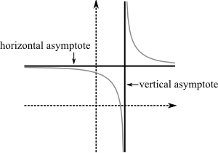
What are other uses of videos? K
  Pose Qs: To internalize Math, physics concepts, ideas?
Others uses videos: Pose Qs to students
One teacher recorded acting out a math problem
  A pizza delivery man drives 538 miles to deliver a pizza
  How long: To get there if he's driving 45 miles per hour?
  This teacher-created video: Driving to Party House
Still others: For content- For future learning
  Fam students with horizontal asymptotes in math
Notes:
horizontal asymptotes (Horizontal asymptotes are horizontal lines that the graph of the function approaches as x tends to +∞ or −∞. As the name indicate they are parallel to the x-axis. Vertical asymptotes are vertical lines (perpendicular to the x-axis) near which the function grows without bound)

Slide 129
Diffeernce normal video/ Screencast? C/ An
  Screen cast: Capture c screen- PPT, voice, faces?
  Lecture: Even outside/ at home?
Creating instructional videos: Daunting?
  Not too difficult?
  But Screencasts/ simple videos: Different?
Screencasts capture our computer screen
  Our PPTs, voices, small webcam of our faces
  A digital for mathematical problem solving lessons
Record 10-15 mts lectures: Outside class time?
Notes:
Screencasts (digital recording of computer screen output, also known as a video screen capture, often containing audio narration)

Slide 130
Is FC a 21st century concept? Who use it first? Syn
What is new? Syn
  Come prepared, read a section, Q by Q- Socrates?
  Technology: Simplified the FC?
Although techno component: Is the new buzz
  Underlying pedagogy: Flipped learning not new
  For centuries: Ask come prepared by reading a section
Flipped model: Simply leverages new technology
  Enables audiovisual option as they prepare for class
  More imp: Redefines class time as S-centered environ

Slide 131
How does a class begin in FIS? K/ Syn
  BBA: Known to unknown Qs?
  FC BBA: Qs by T/S into LOT and HOT?
Look like? Instead of starting off with a lecture
  A class might begin with a Q&A time
Req S: One interesting video Q- Don't know ans to
  As well as notes they took on the recorded lecture
  The teacher gets to interact with each student
  And students get to point out things
  They don't understand or simply wonder about

Slide 132
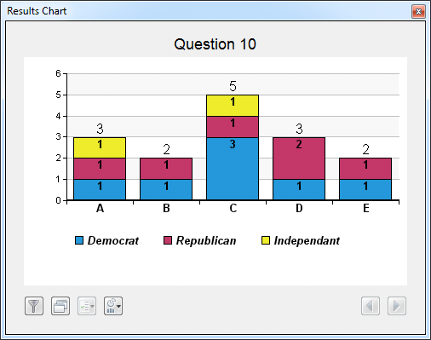
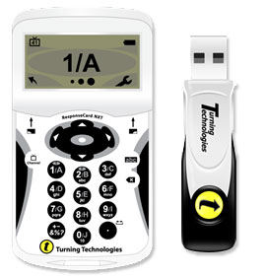
How use videos about Scientific Measurements? Syn
What maj purpose by these? Syn
  Continual formative assessment?
  Clicker polls online/ class, assignment on video?
Seen video about scientific measurement before class
  Check understanding: Clicker poll etc
  Some T: Online form for S-responses/ reactions
After S ans Qs: Assignment based on video
  A measurement activity, problem set, real problem
Enables continual indl S-formative assessment

Slide 133
Describe MLS? C/ Syn
  Techno-BT mesh: Bottom-up/ top-down K-CAASE?
Enter BT/ Mastery Learning Sys (MLS): Chemistry Ts
F meshed with BT: Instructional videos
  Valuable in shifting LOT of BT out of class
  Enabling more class time for HOT
Technology blogger Scott McLeod (2012)
  Whether students needed to move through BT?
  From the bottom up or top/tap down into LOT
Both approaches work: Depends on learner/ DLOs

Slide 134
Other advantages BT-Techno mesh MLS? Syn
  Self-paced learning: Library of videos?
  Ss demo mastery of a DLOs set before next?
Another reason MLS: BT enables self-Paced Learning
Start F: Gradual library of videos/ Screencasts
  Ss have an entire library of instructional videos
  Can now learn at their own pace
Flexible, self-paced BT-based Mastery Learning Sys
Ss demo: Mastered a DLOs set before next

Slide 135
How can S self-pace learning through videos? An
  Work on one subj DLOs: Achieve then move to next?
Can view video (home/ school) when ready for it e.g.
  Need more time to understand chemical bonding
  Before moving on to chemical reactions
  Wherever access to PC/ web-enabled device
Post videos: Online site (MOODLE/ Blackboard)
  Internal district servers, or classroom computers
  Also create lectures-DVDs: For S who select this option
  Equitable access to technology at home?
Notes:
Moodle: Modular Object-Oriented Dynamic Learning Environment

Slide 136
What is special about FC-assessments?
  Conc: K-CAASE excellence vs. grades, competitiveness?
Assessing for Mastery: Assessment model changes
  Exam/ grade: Didn't understand key components- got D
  FC: S req demo min mastery level before go next level
Can allow Ss: Retake any poor assessment
  Multiple opportunities to demo understanding
  If they're unhappy with their prior performance
Also helps remove: Competitive/ punitive components
  Of assessment and of education in general
Notes:
Mach 1 Learning: Massy achievable critical e

Slide 137
What are the 2 natural fits? C/ An
  CAST 2012 UDL and FC K-CAASE paradigm?
  FC: Enables multiple A2E means?
2 Natural Fits: Universal Design for Learning
  CAST 2012: Multiple representation means
  Multiple means of action/ expression, of engagement
How manage our mastery classrooms: Imm realized
  Not all students learn best from video
Just as not all students learn best by
  Reading a textbook, listening to a lecture or
  Completing practice problems
Notes:
Center for Applied Special Technology(CAST): calls for creating curriculum from the outset that provides:
Multiple means of representation to give learners various ways of acquiring information and knowledge,
Multiple means of expression to provide learners alternatives for demonstrating what they know, and
Multiple means of engagement to tap into learners' interests, challenge them appropriately, and motivate them to learn

Slide 138
A2E resources in techno-assisted FC? C
A2E expression modes? C
  Optional: Videos, textbooks, problem sets etc?
  Projects, video games, PPT, posters, blogs?
For all learners: Videos, textbooks, problem sets etc
  Became optional vs. req resources for learning
  S used best suited resources: To master DLOs
Tests contd: But allowed demo K-CAASE several ways
  They could create projects, design video games
  Dev PPT, design posters, curate blogs etc
S could tap their interests/str: To demo understanding

Slide 139
Advantages of Project Based BT Learning? Syn
  PBL: Top-down HOT vs. LOT projects?
  Acid-base chemistry, math analysis in Canada?
Project-Based Learning: Past- Bottom-up on BT
We decided to offer Top-Down projects
  Help S learn HOT material right from start
Proj by Aaron: S collaborated with a class in Canada
  To learn concepts about solutions, acid/ base chemistry
  And math-analysis involved in analytical process
  Past: Aaron would have taught concepts before proj

Slide 140
Added PBL advantage? An
  S met same DLOs by problem solving vs. traditional?
Under F-class, project-based learning model
  S started with the problem to solve
  Watched instructional video when req info
  Went to selected resources/ supports when needed
Students who chose this approach
  Met the same DLOs as those
  Who moved through the traditional methods

Slide 141
How does FC help IEP? Syn
  FC: Flexible, moves up/ down in BT, 1-to-1, rewind?
Individualized Education Program (IEP)
IEP: Needs extra time/ req to process learning
  Sit toward: Front of class and have modified tests
  F-learning model: Easy to accommodate IEP
S can watch lessons multiple times till comprehends
  Likes: Can pause and rewind his teacher!
T can talk to every student: Every class, every day
  Can give indl attention and differentiation he needs
Notes:
IEP: In the United States an Individualized Education Program (IEP) is mandated by the Individuals with Disabilities Education Act (IDEA). In Canada and the United Kingdom, an equivalent document is called an Individual Education Plan.

Slide 142
FC advantage vs. types/ deg of S-competence/ status? Syn
  Can handle novices, almost fluent, new entrants?
  Can handle not read, familiar, read well in IAS?
Allison Spanish teacher: Her 7th grade Spanish class
  Made up of threes-gps
  At school since KG: Almost fluent in Spanish
  Spanish for several years: Struggle with acquisition
  New to Spanish: Just transferred in
By implementing F-MLS: Allison can now
  Effectively teach all three groups at the same time
  Differentiating for S according to fluency-levels
Notes:
MLS- Mastery learning sys

Slide 143
How do you treat the 3 gps? An
  T can move up and down BT-scale?
She moves around the room visiting each gp
  Providing S with instruction as they need it
  When they need it and at the appropriate level
Some students may be viewing a lesson
  Some may be conversing in the language
  Some may be completing grammar lessons
  Others taking assessments in LMS
Notes:
LMS- learning management system

Slide 144
What is the rec focus vs. simple videos and view outside? Syn
F Lessons? C
  F lessons, learning, thinking?
  Time-shift lessons that lend to F?
Getting Started: The term FC implies
  T is recording all lectures: Dir s to view outside class
  This across-board approach not necessary/ beneficial
  Rec Focus: Terms like flipped lessons/ learning/ thinking
  More clearly convey what "flipping" actually means
T carefully considers: Which lessons lend themselves
  To time-shifting direct instruction out of class
  Selective vs. Blanket video-use: Better learning

Slide 145
Impossible video-making: What options? Syn
  Other T’s videos, online SK videos?
  FAMED PPT?
It took a while to dev this approach: Refined along
  Simple: Record all direct lessons for a yr- library
  Consider F one lesson or unit of study/ term
Add videos: Explore new ways to use for instruction
  Or reconsider how you record your lectures anew
  Perhaps Screencasts are the better option
Can’t create own: Use other T’s videos, or on-line
  Pair up with another teacher
Notes:
FAMED: Flipped amended Dual purpose PPTs
FRAME 1: Flipped redone amended PPTs for Easy K-CAASE

Slide 146
How F-classroom gives flex for learning needs of all S? Syn
  LOT at home, move up/ down, 1-t0-1, BBA, KTUK?
Learning at the Center: Education is for everyone
  But the way we deliver / the way students receive edu
  Is not the same for everyone
F-classroom gives teachers the flex
  To meet learning needs of all their students
  Gives S flex: Meet their needs in multiple ways
  Thus creates a classroom that is truly student-centered

Slide 147
Making a Screencast: Equipment Needed
  Screencasting software, such as Camtasia Studio
  A high-quality (not built-in) microphone
  Pen annotation: For math and science classes
  A webcam: If your laptop doesn't have one
  Recording software: With a picture-in-picture feature
  A video camera: To add short clips to the Screencast
Notes:
picture-in-picture feature: that captures a webcam shot of you while you record.

Slide 148
Where to Start
Plan lesson: DLOs vs. whether it lends itself to video
Record video: At PC or before interactive whiteboard
  Teach lesson to absent audience: Purposeful pausing
  No script: S like conversational qualities
Edit video: Correct mistakes, add videos, zoom?
Publish video: Online hosting site (Moodle/ B Board)
  On internal district servers
  Locally on the computers in the classroom
  Burn DVDs

Slide 149
Method: bt based ppt for lot/ hot?
Methodology: Critical Study from net??

Slide 150
How many times most crit study in FRAME-1? K/ C
  6 times: Read, bullets, copy-paste, rationalize, Q, A?
  9 in class: BBA- Discuss from 3 dir each: Q, ans, bullets?
6 step FRAME-1: Download best material from net?
  Read once
  Para as one concept: Make bullets/ sub-bullets
  Copy-paste onto Power Point (Corbel 24/ 22)
  Convert into one liner bullet for single focus
  Key in one liner-BT Qs: For K-CAASE
  Key in one line ans in pink
Discuss class: Flash/ discuss Q, ans, detailed bullets
Notes:
PACE

